Slide 1
Social Anxiety classifier
18.2.2019

Slide 2
The Research
Creating a model for diagnosing SAD based on eye-tracker data only.
Big part of data is taken from Amit’s 2016 paper.
Using machine learning models

Slide 3
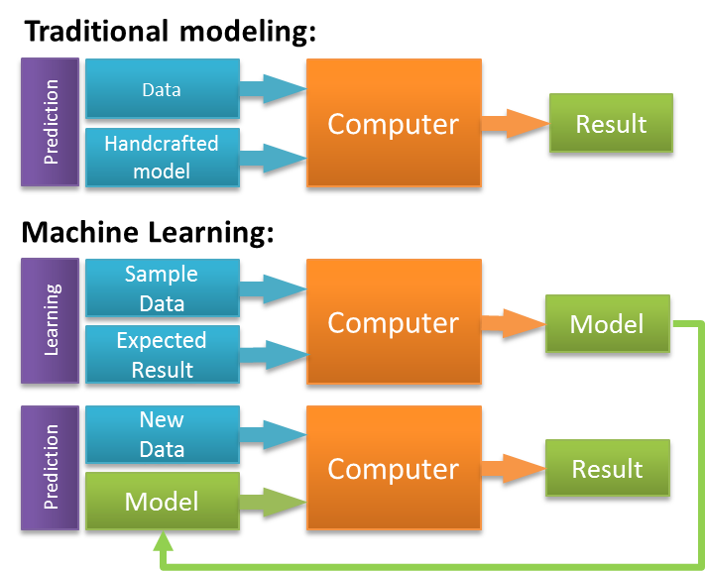
Machine learning
Building models of the data.
Using Tunable inner parameters to fit the data.
After the training, they can predict new data.
In supervised learning we have the desired solution
The models learn to fit the data to it’s label.

Slide 4
The Target
Our label is - LSAS > 50
Number of Positive samples: 45
Number of Negative samples: 34
Positive / Negative ratio – 0.57
Naïve classifier would get 57% accuracy

Slide 5
The Features
The aggregation of each feature is
performed on each of the AOI’s:
- Disgusted - Neutral
- Whitespace
- All AOI’s
Aggregation Features:
Average fixation length
STD fixation length
Average pupil size
STD pupil size
Average Fixation length
Average Disgusted Fixation length
Average Neutral Fixation length

Slide 6
The Features
Ratios between average fixation length on different AOI’s
variance of the ratio Disgusted/Disgusted + Neutral between the trials.
Average of the different number of AOI in each trial.
Total number of features – 29
Total number of samples – 79

Slide 7
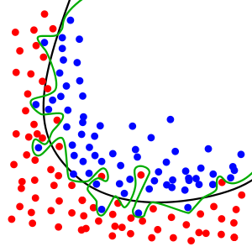
How to get the results?
Estimating our pipeline accuracy
Estimating our pipeline ability to generalize
Avoiding overfitting
Pipeline -
preprocessing
Model Creation

Slide 8
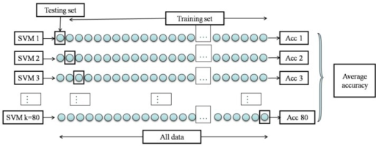
Leave One Out Cross Validation
The average accuracy of testing 79 pipelines
This method has high variance
Leave one sample out of the set
Create model without this sample
Predict the one left aside
Correct?
Save the result & repeat

Slide 9
Pipeline
Remove missing values
Min Max Scaling
Correlation Threshold
Recursive Feature Elimination
Gradient Boosting Classifier

Slide 10

Preprocessing
Min Max Scaler:
We want all the features to be in the same scale
This scaler puts all the features between 0-1
Correlation Threshold:
Removing features which are highly correlated (Pearson > 0.7)

Slide 11
Recursive Feature Elimination
The goal is to select the optimal subset of features.
The predictor is trained on the initial set of features and gets the importance of each feature.
The least important features are pruned from the set of features.
That procedure is recursively repeated on the pruned set until the desired number of features is reached.
feature importance estimation done by random forest

Slide 12
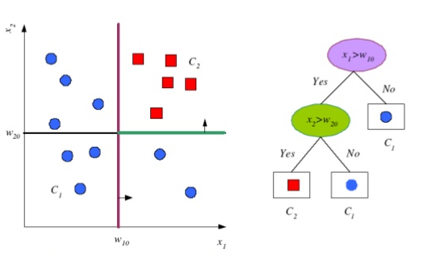
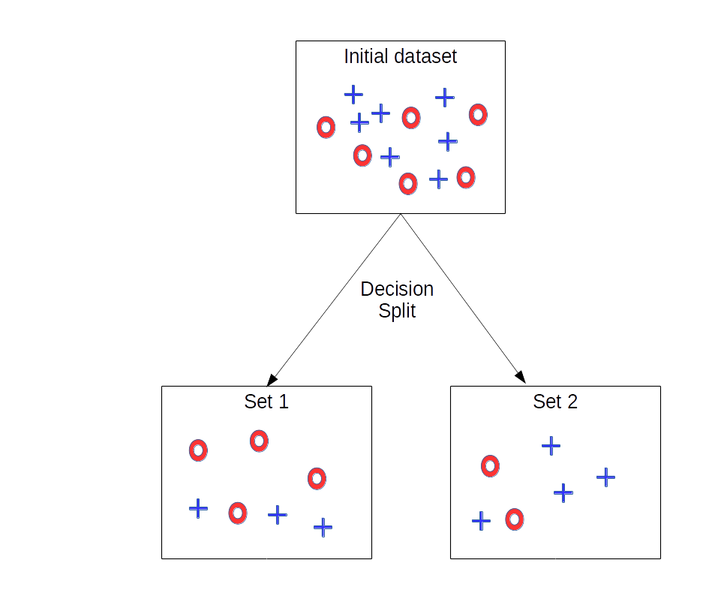
Decision tree
Random forest is closely a bag of decision trees
Decision tree split in the way that minimize the impurity
The most important features chosen first.

Slide 13
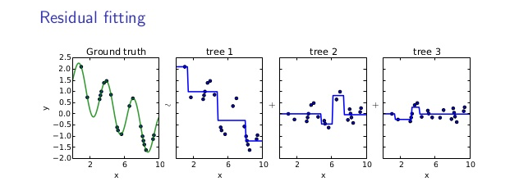
Gradient Boosting Classifier
Learn sequence of predictors (decision trees)
Each predictor learns the mistakes of the previous.
Sum of predictions is increasingly accurate
Predictive function is increasingly complex

Slide 14
Hyperparameter tuning
Finding the best classifier for the data
Recursive Feature Elimination:
n_features_to_select = 11
Gradient boosting:
n_estimators = 400, max_depth = 6, learning_rate = 0.05

Slide 15
Results
Cross Validation results: accuracy – 71%
Test set results: accuracy - 71%
39% True Positive
33% True Negative
0% False Negative
29% False Positive

Slide 16
Discussion
Our target – finding a way to diagnose SAD without self reporting questions.
Should we get more data?

